Slide 1
Nano-Particle Analysis Using Computer Vision
A Programmatic Approach

Slide 2
SIGNIFICANCE OF NANO – PARTICLES :
Nano-Particle Analysis plays a pivotal role in understanding the properties and behavior of materials at the nanoscale.
Enables researchers to study and manipulate materials at the molecular and atomic levels.
Critical for advancements in fields such as medicine, electronics, and materials science.
Provides insights into the development of innovative materials with enhanced properties, leading to groundbreaking applications.

Slide 3
CONTRIBUTION OF COMPUTER VISION :
Computer vision automates Nano-Particle Analysis, improving efficiency and accuracy.
Enables the extraction of valuable insights from complex nano-scale images.
Facilitates the rapid analysis of large datasets, enhancing the pace of nano-technology research.
Supports real-time monitoring and adjustments, allowing for dynamic and responsive analysis in evolving experimental conditions.

Slide 4
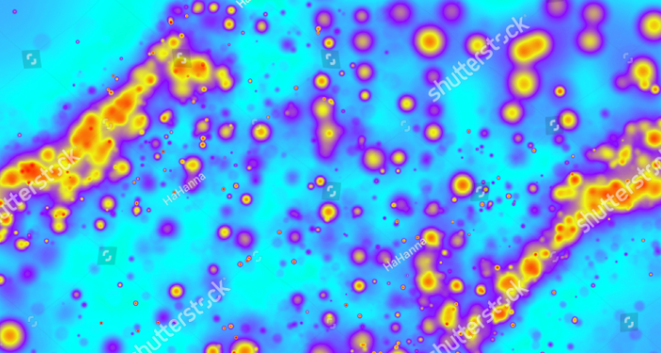
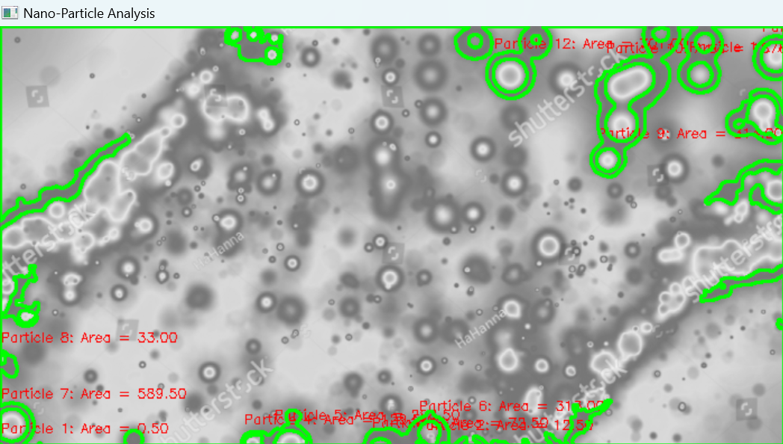
PROGRAM STRUCTURE :
import cv2
import numpy as np
image = cv2.imread("C:/Users/HP/Pictures/Pictures/vivo v 23/Facebook/nano 2.png", 0)
preprocessed_image = cv2.GaussianBlur(image, (5, 5), 0)
ret, binary_image = cv2.threshold(preprocessed_image, 127, 255, cv2.THRESH_BINARY)
contours, _ = cv2.findContours(binary_image, cv2.RETR_EXTERNAL, cv2.CHAIN_APPROX_SIMPLE)
areas = [cv2.contourArea(contour) for contour in contours]
result_image = cv2.cvtColor(image, cv2.COLOR_GRAY2BGR)
for i, contour in enumerate(contours):
cv2.drawContours(result_image, [contour], 0, (0, 255, 0), 2)
x, y, _, _ = cv2.boundingRect(contour)
cv2.putText(result_image, f'Particle {i + 1}: Area = {areas[i]:.2f}', (x, y - 10), cv2.FONT_HERSHEY_SIMPLEX, 0.4, (0, 0, 255), 1)
cv2.imshow('Nano-Particle Analysis', result_image)
cv2.waitKey(0)
cv2.destroyAllWindows()

Slide 5
FLOW CHART :
1
2
3
PREPROCESSING
4
5
6
7
LOAD NANO SCALE IMAGE
SEGMENTATION
CONTOUR DETECTION
FEATURE EXTRACTION
VISUALIZATION AND OUTPUT
START

Slide 6
EXPLANATION :
Start: The program begins.
Load Nano-Scale Image: The nano-scale image is loaded into the program.
Preprocessing: Preprocessing steps, such as Gaussian blur for noise reduction, are applied to enhance the image.
Segmentation: The preprocessed image is thresholded to segment the nano-particles from the background.
Contour Detection: Contours are detected around the segmented nano-particles.
Feature Extraction: Features, such as the area of each nano-particle, are extracted.
Visualization and Output: The program visualizes the results, overlaying contours and displaying feature information on the original image.
End: The program concludes.

Slide 7
FUTURE EXTENSIONS :
Exploration of advanced computer vision techniques for more robust segmentation and feature extraction.
Consideration of additional features or parameters for a deeper analysis of nano-particles.
Integration of machine learning approaches for adaptive analysis and improved recognition.
Extension of the project to handle diverse datasets and experimental setups.

Slide 8
CONCLUSION :
Automating Nano-Particle Analysis
Advancing Research Capabilities
Visualization Enhancements
Continuous Improvement and Collaboration
THANK YOU

